Slide 1
CMP5329 Cyber Security
Week 7: Injection Attacks and Defenses
PhD. Ngoc-Tu Nguyen
tunn@uit.edu.vn

Slide 2
Security goals
Goals
Cipher systems
- Symmetric (DES, AES)
- Asymmetric (RSA, ECC, CRYSTALS-KYBER)
Confidentiality
Privacy
Integrity
Hash functions
Message authentication code (MAC)
Digital signature (digital certificate)
Authentication
Non-repudiation (Accountability)
Access control
DAC, MAC, RBAC, ABAC, PBAC
Availability

Slide 3
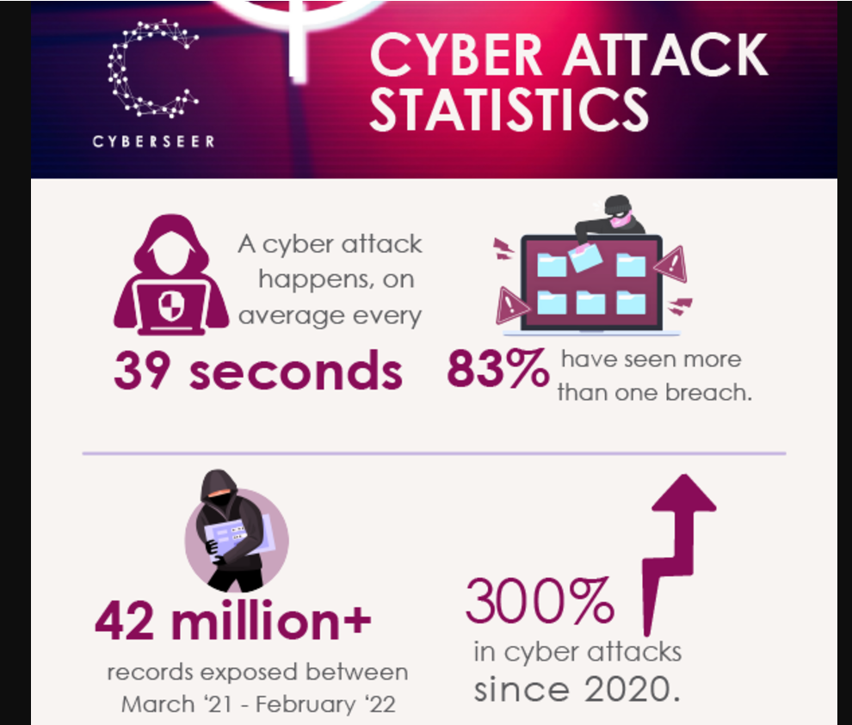
Case study

Slide 4
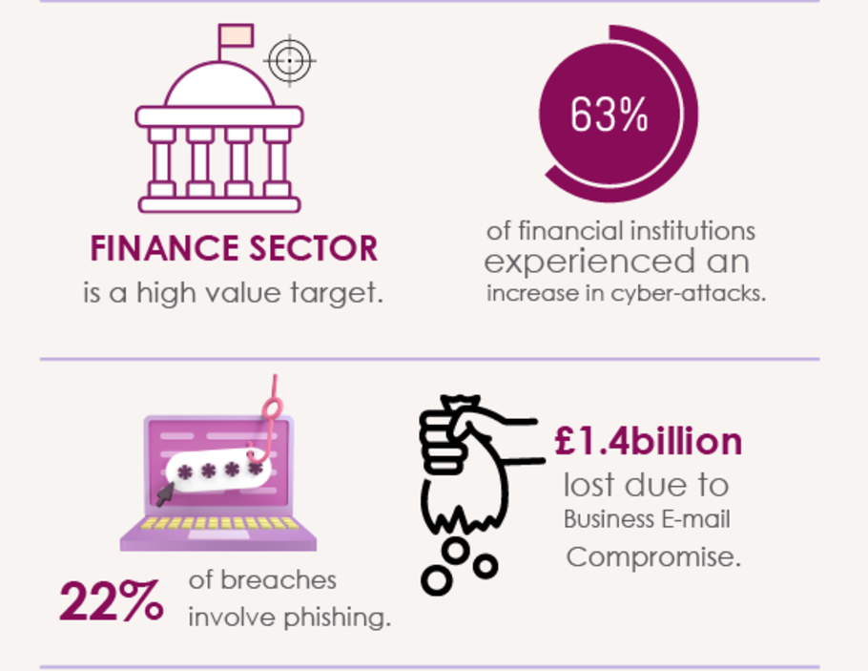
Case study
 https://blog.cyberseer.net/infographic-cyber-attack-statistics

Slide 5
Case study
Cybersecurity breaches can cost millions and damage reputations.
Equifax Data Breach (2017, identity theft): Affected 147 million people; SQL injection vulnerability.
☞ https://en.wikipedia.org/wiki/2017_Equifax_data_breach
British Airways (2018): 400,000 customer accounts compromised; exploitation of injection flaws.
☞ https://en.wikipedia.org/wiki/British_Airways_data_breach
Capital One (2019): Data of 100 million users leaked due to weak firewall configuration.
☞ https://dl.acm.org/doi/10.1145/3546068
VnDirect bị tấn công mã hóa dữ liệu
☞ https://vietnamnet.vn/ma-doc-ma-hoa-du-lieu-tong-tien-lockbit-3-0-tan-cong-vndirect-nguy-hiem-the-nao-2271741.html

Slide 6
The Cyber Threat Landscape
Increasing sophistication of attackers and techniques.
Injection vulnerabilities remain a top attack vector.
Common targets:
Web applications
APIs
IoT devices
Impact: financial loss, legal consequences, erosion of trust.
Pie chart of most common attack types.
Timeline of recent major cybersecurity incidents.

Slide 7
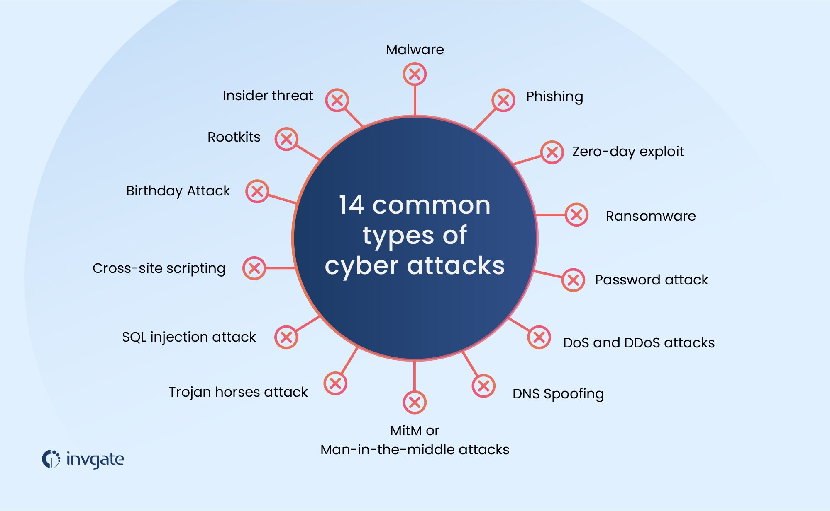
The Cyber Threat Landscape
 https://blog.invgate.com/types-of-cyber-attacks

Slide 8
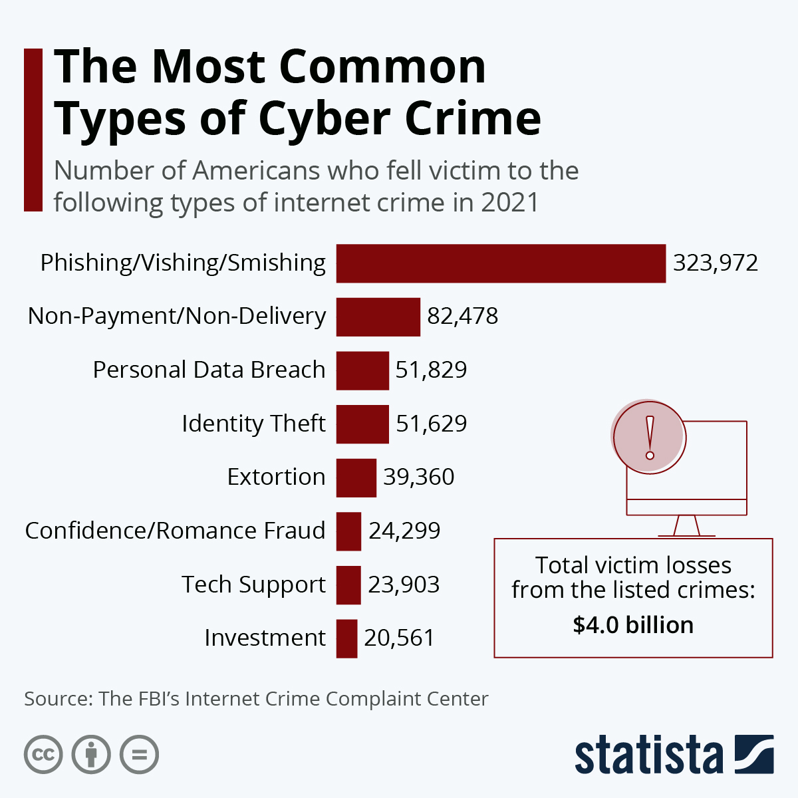
The Cyber Threat Landscape
Types of cyber crime
https://www.statista.com/chart/24593/most-common-types-of-cyber-crime/

Slide 9
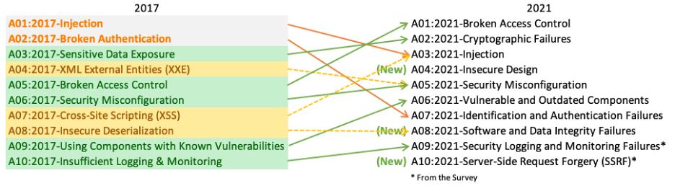
Introducing OWASP – Purpose and Role
The Open Web Application Security Project (OWASP) is a non-profit organization focused on improving software security.
Provides tools, resources, and guidelines for secure application development.
The OWASP Top 10 is a widely recognized list of the most critical security risks to web applications.
 https://owasp.org/www-project-top-ten/

Slide 10
SQL Injection
Definition: SQL injection is a code injection technique that exploits vulnerabilities in an application by injecting malicious SQL statements into a query.
How it works:
Attacker sends specially crafted input to manipulate SQL queries.
Bypasses authentication or retrieves sensitive data.
Examples:
' OR '1'='1 for bypassing login.
UNION SELECT username, password FROM users; for data extraction.
Example:
https://owasp.org/www-community/attacks/SQL_Injection_Bypassing_WAF

Slide 11
Command Injection
Definition: Command injection occurs when attackers execute arbitrary commands on a host operating system via a vulnerable application.
How it works:
User input is improperly validated and passed directly to shell commands.
Results in remote code execution or privilege escalation.
Examples:
; rm -rf / in a vulnerable file upload form.
Injecting & cat /etc/passwd into a web form.

Slide 12
Cross-Site Scripting (XSS)
Definition: XSS is a vulnerability that allows attackers to inject malicious scripts into trusted websites.
Types of XSS:
Stored XSS: Malicious script is stored on the server (e.g., in a database).
Reflected XSS: Script is immediately executed as part of the HTTP request.
DOM-based XSS: Vulnerability in client-side JavaScript.
Examples:
<script>alert('XSS');</script> in a comment field.
URL parameter injection with <img src=x onerror=alert('XSS')>

Slide 13
Code Injection vs File Inclusion (LFI/RFI)
Code Injection: Direct injection of malicious code into a running application.
Example: Injecting eval() or Python code in a vulnerable script.
File Inclusion: Exploiting file paths to include unauthorized files.
LFI (Local File Inclusion): Loading local system files.
Example: ../../etc/passwd.
RFI (Remote File Inclusion): Loading files from external servers.
Example: http://attacker.com/malware.php.
Differences:
Code injection focuses on altering application logic.
File inclusion targets access to files, leading to further exploits.

Slide 14
Anatomy of an Injection Attack
Overview: Injection attacks occur when untrusted data is improperly handled, leading to unintended execution of commands or queries.
Steps of an Injection Attack:
Reconnaissance: Identifying injection points in the target application.
Payload Delivery: Crafting and injecting malicious input.
Execution: Vulnerable system executes the injected code.
Exploitation: Attacker gains unauthorized access or exfiltrates data.

Slide 15
SQL Injection Techniques (Union-Based, Blind)
Union-Based SQL Injection:
Combines results of two queries into a single dataset.
Example:
SELECT username, password FROM users UNION SELECT version(), user();
Blind SQL Injection:
Exploits a database by asking true/false questions.
Example:
SELECT * FROM users WHERE id=1 AND 1=1;
True: Returns data.
False: Returns no data.

Slide 16
Command Injection Techniques (OS Commanding)
OS Commanding: Leveraging vulnerabilities to execute shell commands.
Example payloads:
; ls -la
&& cat /etc/passwd
Common Attack Scenarios:
Exploiting file upload forms to execute commands.
Injecting commands into web application input fields.
Impact: Remote execution of commands, full system compromise.

Slide 17
Exploiting XSS (Stored, Reflected, DOM-based)
Stored XSS:
Malicious script is saved on the server and executed when a user accesses it.
Example: Injecting <script>alert('Stored XSS');</script> into a comment field.
Reflected XSS:
Payload is included in the request and reflected in the server’s response.
Example: Injecting <script>alert('Reflected XSS');</script> in a URL parameter.
DOM-based XSS:
Exploits client-side JavaScript to modify the DOM.
Example: Injecting into document.write().

Slide 18
Payload Delivery Mechanisms
What is a Payload?
Malicious input that carries commands or exploits.
Methods of Delivery:
User Input Fields: Injected through forms or fields.
URL Parameters: Delivered via GET/POST requests.
Cookies: Manipulated to contain malicious payloads.
File Uploads: Used to deliver executable scripts.
Characteristics of Effective Payloads:
Stealthy and hard to detect.
Exploits specific vulnerabilities in the target system.

Slide 19
SQL Injection Example (with code)
Scenario: Bypassing a login screen using SQL injection.
Vulnerable Code:
SELECT * FROM users WHERE username = 'user' AND password = 'pass';
Malicious Input:
Username: ' OR '1'='1
Password: --
Injected Query:
SELECT * FROM users WHERE username = '' OR '1'='1' -- ' AND password = '';
Bypasses authentication by always returning true.
Impact: Unauthorized access to user accounts.

Slide 20
XSS Example (with code)
Scenario: Stored XSS in a blog comment system.

Slide 21
Command Injection Example (with shell output)
Scenario: Uploading a file to exploit a command injection vulnerability.
Vulnerable Code:
os.system("ls " + filename)
Malicious Input:
Filename: ; rm -rf /
Result:
Deletes all files on the system.
Mitigation: Avoid using system calls with untrusted input.

Slide 22
Real-world Exploit Cases
Case 1: Equifax Breach (2017):
SQL Injection vulnerability led to data of 147 million people being exposed.
Case 2: TalkTalk Breach (2015):
SQL Injection exposed sensitive customer data.
Case 3: Magento Vulnerability:
XSS exploited in e-commerce systems to steal payment details.
Key Lessons Learned:
The importance of secure coding and regular vulnerability assessments.

Slide 23
Tools and Scripts Used in Injection Exploits
Commonly Used Tools:
SQLMap: Automates SQL injection and database takeover.
Burp Suite: Comprehensive web vulnerability scanner with injection exploit modules.
OWASP ZAP: Open-source proxy for finding injection vulnerabilities.
Metasploit: Framework for exploiting injection and other vulnerabilities.
Custom Scripts:
Written in Python, Bash, or PowerShell for tailored exploits.
Example: Automating Blind SQL Injection queries.
Purpose of Tools:
Reconnaissance, exploitation, and post-exploit data extraction.

Slide 24
Commonly Exploited Systems and Applications
Web Applications:
E-commerce sites, blogs, and content management systems (e.g., WordPress, Joomla).
Vulnerabilities: SQL injection, XSS, and RFI.
APIs:
RESTful APIs with insufficient input validation.
Exploited for data exfiltration.
IoT Devices:
Lack of secure coding leads to command injection vulnerabilities.
Databases:
MySQL, PostgreSQL, and Oracle DB are common targets.
Case Studies:
Exploiting outdated software versions with known vulnerabilities.

Slide 25
Overview of AAA Model and Its Role in Security
What is AAA?
Authentication: Verifying user identity.
Authorization: Granting access based on permissions.
Accounting: Logging and tracking activities.
Flow: Authentication -> Authorization -> Accounting.
Importance in Security:
Ensures only legitimate users access resources.
Tracks user actions to detect potential attacks.
Key Applications:
Network security, database access, and web applications.

Slide 26
Authentication Techniques (Passwords, MFA, Biometrics)
Traditional Authentication:
Password-based systems.
Common weaknesses: weak passwords, reuse, and credential leaks.
Advanced Authentication Techniques:
Multi-Factor Authentication (MFA):
Combines two or more factors (e.g., password and OTP).
Biometric Authentication:
Fingerprints, facial recognition, or iris scanning.
Hardware Tokens:
Physical devices (e.g., YubiKeys) for secure login.

Slide 27
Authorization Models (DAC, MAC, RBAC, ABAC, PBAC)
Types of Authorization Models:
DAC (Discretionary Access Control): Owner-controlled permissions.
MAC (Mandatory Access Control): Centralized policy enforcement.
RBAC (Role-Based Access Control): Permissions based on user roles.
ABAC (Attribute-Based Access Control): Context-aware access based on attributes.
PBAC (Policy-Based Access Control): Policy-driven and flexible.
Use Cases:
RBAC in enterprises (e.g., admin, user roles).
ABAC for dynamic cloud-based systems.

Slide 28
Accounting and Logging for Attack Detection
Purpose of Accounting:
Record user activities for auditing and forensics.
Detect anomalies and potential security breaches.
Logging Best Practices:
Centralized logging for correlation.
Store logs securely to prevent tampering.
Regularly review logs for suspicious activity.
Examples:
Monitoring login attempts to detect brute-force attacks.
Tracking changes to critical configurations.

Slide 29
AAA in the Context of Injection Attacks
Authentication:
Prevent unauthorized access to vulnerable systems.
Use MFA to reduce risks of credential stuffing.
Authorization:
Restrict user permissions to minimize attack surface.
Example: RBAC prevents users from accessing critical SQL queries.
Accounting:
Track unauthorized query executions and command injections.
Example: Detect and block repeated injection attempts.

Slide 30
Input Validation and Output Encoding
Input Validation:
Ensure that user input conforms to expected formats.
Techniques:
Whitelisting acceptable input.
Rejecting inputs with unexpected characters (e.g., <>, ';--).
Output Encoding:
Convert untrusted data into a safe format before rendering.
Protects against XSS by encoding characters like < as &lt;.
Best Practices:
Validate all inputs on the server-side.
Use libraries for encoding HTML, JSON, and SQL outputs.

Slide 31
Parameterized Queries and Prepared Statements
What are Parameterized Queries?
SQL statements with placeholders for parameters.
Prevents attackers from injecting malicious SQL by separating query structure and data.
Example (Vulnerable Code):
SELECT * FROM users WHERE username = '" + user + "' AND password = '" + pass + "';
Secure Code with Prepared Statements:
PreparedStatement stmt = conn.prepareStatement("SELECT * FROM users WHERE username = ? AND password = ?");
stmt.setString(1, user);
stmt.setString(2, pass);
Impact: Blocks SQL injection entirely.

Slide 32
Security Testing – Fuzzing and Penetration Testing
Fuzzing:
Automated testing with unexpected or invalid input to identify vulnerabilities.
Example tools: AFL, Peach.
Penetration Testing:
Simulates real-world attacks to assess system security.
Manual or automated tests, often using tools like Metasploit.
Importance:
Proactively identifies vulnerabilities before attackers exploit them.

Slide 33
Using Web Application Firewalls (WAF)
What is a WAF?
A security solution that monitors and filters HTTP traffic to web applications.
How it Helps:
Blocks known injection payloads.
Detects and mitigates suspicious activity in real-time.
Examples of WAFs:
ModSecurity, AWS WAF, Cloudflare WAF.
Best Practices:
Regularly update WAF rules to handle evolving threats.

Slide 34
Content Security Policy (CSP) for XSS
What is CSP?
A browser-based security mechanism to prevent XSS attacks.
How it Works:
Defines which resources are trusted (scripts, styles, etc.).
Blocks inline scripts and unauthorized resource loading.
Example CSP Header:
Content-Security-Policy: script-src 'self'; object-src 'none';
Advantages:
Prevents execution of malicious scripts.
Works as an additional layer of security alongside input validation.

Slide 35
Role of NAC in Preventing Unauthorized Access
What is NAC?
Network Access Control ensures that only authorized users and devices can access the network.
Key Features of NAC:
Identity verification before granting access.
Monitoring and managing connected devices.
Dynamic response to unauthorized access attempts.
Role in Security:
Blocks compromised devices from spreading malicious payloads.
Enforces security policies across the network.

Slide 36
Configuring Firewalls to Block Injection Attacks
Firewall Rules for Injection Protection:
Block requests containing suspicious payloads (e.g., SQL commands).
Restrict access to critical application ports.
Example Firewall Rules:
Block HTTP requests with UNION SELECT.
Allow only whitelisted IPs for admin access.
Types of Firewalls:
Network-based firewalls (protect at the perimeter).
Application-layer firewalls (focus on HTTP/S traffic).

Slide 37
Deep Packet Inspection and Threat Signatures
What is Deep Packet Inspection (DPI)?
Analyzing packet contents for malicious patterns.
Threat Signatures:
Predefined patterns used to identify and block known exploits.
Use Cases:
Detecting SQL injection attempts in HTTP traffic.
Identifying malware command-and-control communications.
Challenges:
Requires significant processing power.
Must stay updated with evolving threats.

Slide 38
Zero Trust Architecture for Enhanced Security
Principle of Zero Trust:
Never trust, always verify.
Core Components:
Identity-based access control.
Continuous authentication and monitoring.
Micro-segmentation to isolate resources.
Benefits in Preventing Injection Attacks:
Reduces attack surface by restricting lateral movement.
Ensures all requests are verified before granting access.

Slide 39
Integrating NAC with Monitoring Tools (SIEM)
What is SIEM?
Security Information and Event Management combines real-time monitoring with log analysis.
Benefits of Integration:
NAC enforces access control, and SIEM monitors and analyzes activity.
Detects patterns of malicious behavior across the network.
Example Use Cases:
Alerting on repeated access attempts from a single IP.
Correlating suspicious network activity with NAC logs.

Slide 40
Incident Detection and Alert Mechanisms
What is Incident Detection?
Identifying unusual or malicious activities within a system.
Key Components of Detection:
Log monitoring and analysis.
Intrusion Detection Systems (IDS) and Intrusion Prevention Systems (IPS).
Threat intelligence feeds.
Alert Mechanisms:
Real-time notifications for suspicious activities.
Example: Email or SMS alerts triggered by failed login attempts or detected injection patterns.

Slide 41
Steps to Contain an Injection Attack
Containment Steps:
Identify the Scope: Determine affected systems and users.
Isolate Impacted Systems: Disconnect from the network if necessary.
Block Malicious Traffic: Update firewall and NAC rules.
Disable Vulnerable Functions: Temporarily shut down affected application modules.
Minimizing Further Damage:
Stop the attacker's access while preserving evidence for investigation.

Slide 42
Mitigation Strategies Post-Injection Breach
Immediate Actions:
Change compromised credentials.
Patch vulnerabilities exploited in the attack.
Long-term Strategies:
Enhance monitoring to detect similar attacks.
Conduct regular security audits.
Train staff on secure coding and response protocols.
Examples:
SQL Injection: Implement prepared statements.
Command Injection: Review and sanitize system calls.

Slide 43
Root Cause Analysis – Learning from Attacks
What is Root Cause Analysis (RCA)?
Identifying underlying issues that led to the attack.
Steps in RCA:
Analyze logs and system events to trace the attack vector.
Interview stakeholders to understand workflows.
Identify policy, process, or technology gaps.
Benefits:
Prevents recurrence of similar attacks.
Improves organizational security posture.

Slide 44
Developing a Comprehensive Incident Response Plan
What is an Incident Response Plan (IRP)?
A documented approach to detecting, responding to, and recovering from attacks.
Key Components:
Roles and responsibilities.
Step-by-step response procedures.
Communication plan for stakeholders.
Example IRP Framework:
Preparation -> Detection -> Containment -> Eradication -> Recovery -> Lessons Learned.

Slide 45
Recap of Key Points Covered in the Lecture
Injection Attacks: Types, Techniques, and Examples.
Defense Strategies: Input Validation, Prepared Statements, WAF, CSP.
Incident Response: Detection, Containment, and Mitigation Strategies.

Slide 46
Importance of a Holistic Defense Approach
Combines prevention, detection, and response for comprehensive security.
Layered Security: Firewalls, WAF, NAC, and Secure Coding Practices.
Continuous Monitoring and Alerts to reduce attack impact.

Slide 47
Tools and Resources for Further Learning
Tools: OWASP ZAP, Burp Suite, Metasploit, SQLMap.
Resources: OWASP guidelines, TryHackMe, Cybrary, "The Web Application Hacker’s Handbook".
Importance of staying updated with evolving threats.

Slide 48
Research Topics Include AI, ML
AI for Threat Detection: Using ML for anomaly detection and behavioral analysis.
Automation in Incident Response: AI-powered tools for faster detection and mitigation.
Adversarial Attacks on AI Systems: Exploring weaknesses in AI/ML algorithms.

Slide 49
Slide 50: Q&A Session

